Slide 1
Attention is all you need
논문 리딩
Model architecture

Slide 2
Transformer
Input sequence (x1, … , xn)
encoder
z = (z1, … , zn)
decoder
output sequence (y1, … , yn)

Slide 3
Transformer - encoder
Feed-Forward
Network
각 sub-layer(feed-forward network,
multi-head attention)의 output은
Layer normalization 사용
Residual connection
X 6
Multi-Head
Attention

Slide 4
Transformer – decoder
Feed-Forward
Network
각 sub-layer(feed-forward network,
multi-head attention)의 output은
Layer normalization 사용
Multi-Head
Attention
X 6
Residual connection
Multi-Head
Attention

Slide 5
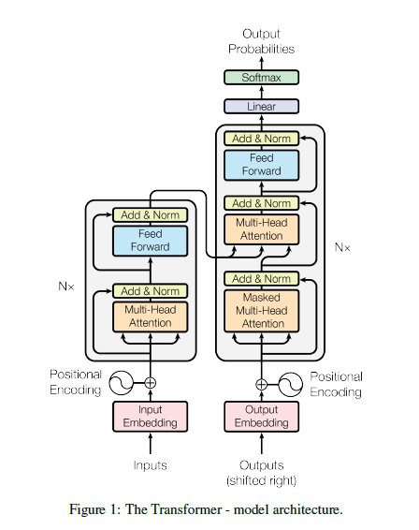
Layer normalization
논문 내용: The output of each sub-layer is LayerNorm(x+Sublayer(x))
Sublayer(x)
x
Add:
x+Sublayer(x)
Norm:
LayerNorm(x+Sublayer(x))

Slide 6
Attention
query와 set of key-value pair를 output으로 매핑
query, key, value, output 모두 vector
output: weighted sum of values
weight: query와 그에 상응하는 key를 통해 계산됨

Slide 7
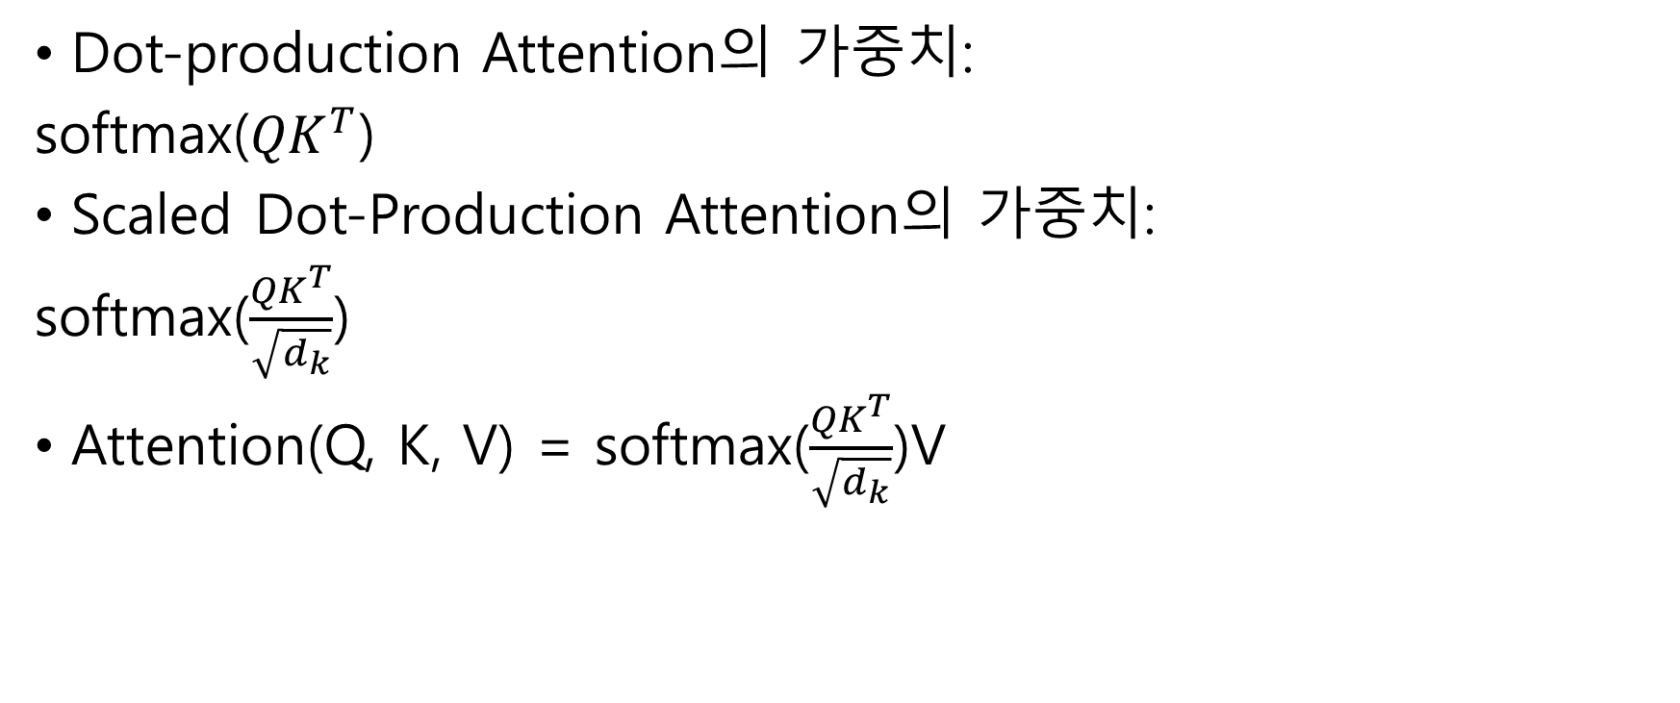
Scaled Dot-Product Attention
Dot-production Attention의 가중치:
softmax(${QK}^{T}$)
Scaled Dot-Production Attention의 가중치:
softmax($\frac{{QK}^{T}}{\sqrt{d_{k}}}$)
Attention(Q, K, V) = softmax($\frac{{QK}^{T}}{\sqrt{d_{k}}}$)V

Slide 8
Scaled Dot-Product Attention
Matmul
Softmax
Scaled Dot-Product
Attention
Scale
Q
K
V
Matmul
Q
K
V

Slide 9

Multi-Head Attention
Q
C
O
N
C
A
T
linear
Scaled
Dot-
Product
Attention
R1
K
linear
R2
V
linear
h
linear
Q
linear
Scaled
Dot-
Product
Attention
linear?
데이터 쪼개기?
AxWA라 한다면, dmodelXdA크기의 WA를 통해 A를 dA 크기의 vector로 쪼갬
K
linear
Rh
V
linear
Notes:
dA인가? Dmodel인가?

Slide 10
Position-wise Feed-Forward Networks
Two linear transformations with a ReLU activation in between
FFN(x) = max(0, xW1+b1)W2 + b2

Slide 11
Embeddings and Softmax
Decoder output → predicted next-token probabilities
Input token & output token → vector of dimension dmodel

Slide 12

Positional Encoding
Reason: no recurrence, no convolution → don’t know seq

Slide 13
Confusing Part
논문 중
While two are similar in theoretical complexity, dot-product attention is much faster and more space-efficient in practice, since it can be implemented using highly optimized matrix multiplication code.
While for small values of dk the two mechanisms perform similarly, additive attention outperforms dot product attention without scaling for larger values of dk.
Multi-head attention의 linear
AXWA의 결과가 dA인가 dmodel인가?
Notes:
Additive attention: 단일 hidden layer의 feed-forward 네트워크를 사용하여 호환성 함수를 계산한다. dkdk가 작을 때 성능이 더 좋다.
Dot-product attention: dkdk가 더 클 때는 빠른 행렬곱 알고리즘에 힘입어 더 빠르고 더 공간 효율적이다.

Slide 14
Transformer – decoder
Feed-Forward
Network
각 sub-layer(feed-forward network,
multi-head attention)의 output은
Layer normalization 사용
Multi-Head
Attention
X 6
Residual connection
Multi-Head
Attention

Slide 15
Layer normalization
논문 내용: The output of each sub-layer is LayerNorm(x+Sublayer(x))
Sublayer(x)
x
Add:
x+Sublayer(x)
Norm:
LayerNorm(x+Sublayer(x))

Slide 16
Multi-Head Attention
Q
C
O
N
C
A
T
linear
Scaled
Dot-
Product
Attention
R1
K
linear
R2
V
linear
h
linear
+Example
Q
linear
Scaled
Dot-
Product
Attention
linear?
데이터 쪼개기?
AxWA라 한다면, dmodelXdA크기의 WA를 통해 A를 dA 크기의 vector로 쪼갬
K
linear
Rh
V
linear

Slide 17
Position-wise Feed-Forward Networks
Two linear transformations with a ReLU activation in between
FFN(x) = max(0, xW1+b1)W2 + b2

Slide 18
Embeddings and Softmax
+Example
Decoder output → predicted next-token probabilities
Input token & output token → vector of dimension dmodel

Slide 19
Positional Encoding
Reason: no recurrence, no convolution → don’t know seq

Slide 20
To-do list
Residual Connection이란?
LayerNorm은 어떤 계산인가?
Multi-Head Attention의 계산 예시와, Linear가 무엇인지
Position-wise Feed-Forward Networks란?
ReLU란?
Embedding and Softmax 계산 예시와, predicted next-token probabilities의 사용법에 관하여
Positional Encoding의 세부과정

